Slide 1
Group Discussion

Slide 2
What is Group Discussion
People sit together- form group - discuss to do something, to solve some issues, to find solutions for some problems...
To be short it is a process of decision making
In everybody’s house

Slide 6
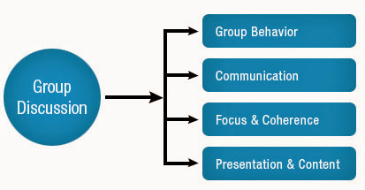

Slide 7
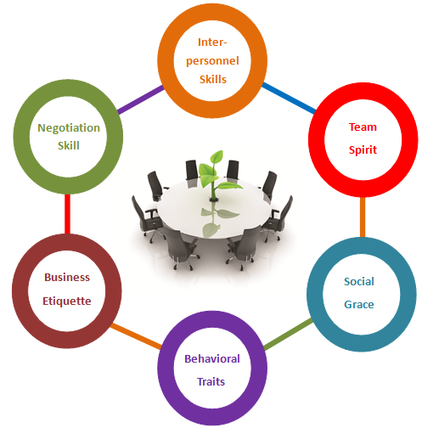

Slide 15
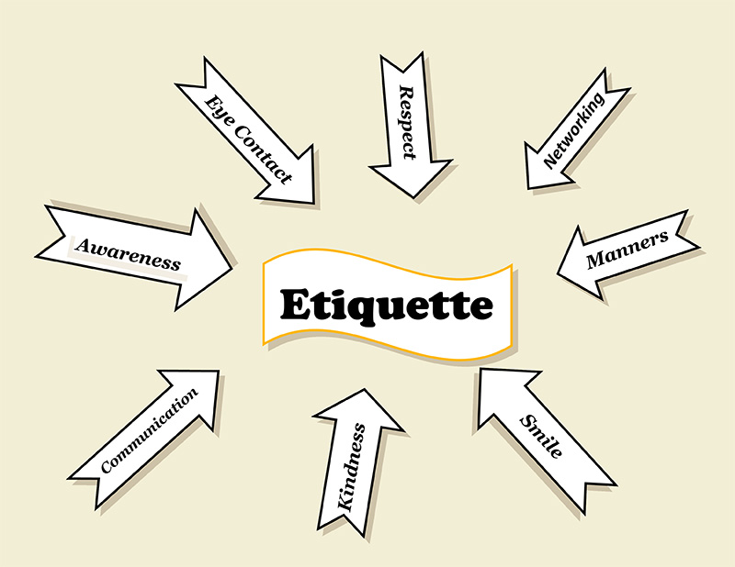

Slide 17
